Slide 1
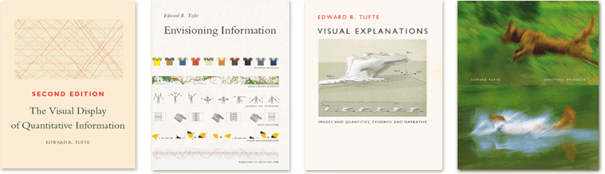
Thinking Graphically
Lessons From Edward Tufte
Slides adapted from presentation by Mika Aldaba, Graphic Designer

Slide 2
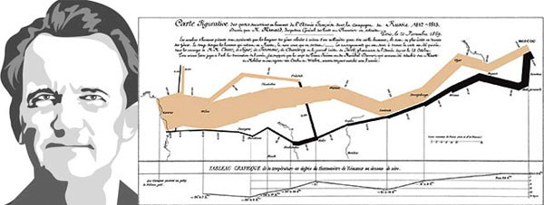
Who Is Edward Tufte?
an analytical design theorist, educator, and landscape sculptor best known for his self-published books on analytical design
Illustrated by Merchant for the Brunswick Review

Slide 3
Anscombe’s Quartet
How would you describe the differences in these datasets?

Slide 4
Anscombe’s Quartet
Metric | Value
mean of the y values | 7.5
equation of the least-squared regression line | y = 3 + 0.5x
sums of squared errors (about the mean) | 110
regression sums of squared errors (variance accounted for by x) | 27.5
residual sums of squared errors (about the regression line) | 13.75
correlation coefficient | 0.82
coefficient of determination | 0.67

Slide 5
Anscombe’s Quartet
Graphics reveal data

Slide 6
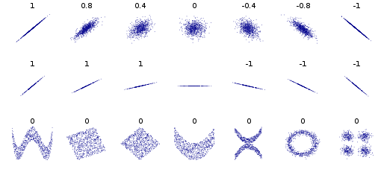
Another example: Pearson Correlation

Slide 7
Other reasons?
Visualization is the highest bandwidth channel into the human brain
As data volumes grow, visualization becomes a necessity rather than a luxury.
“A picture is worth a thousand words”

Slide 8
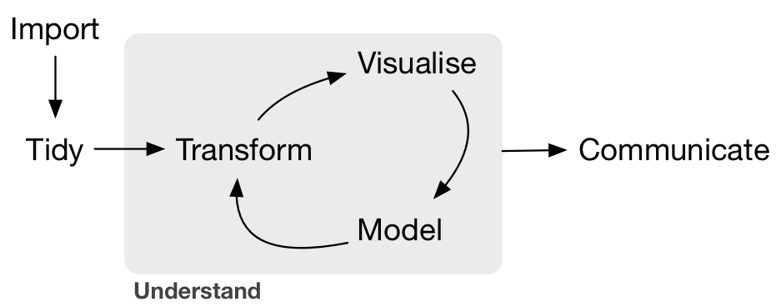
Visualization is important…
--Grolemund & Wickham, R for Data Science, O'Reilly 2016

Slide 9
Graphical Excellence
Show the data
Induce the viewer to think about substance rather than methodology
Avoid distortion
Present many numbers in a small space
Make large data sets coherent
Encourage comparisons
Reveal the data at several levels from broad overview to fine structure
Serve a purpose
Be integrated with statistical and verbal descriptions of data
-- Principles of Graphical Excellence, Edward Tufte

Slide 10
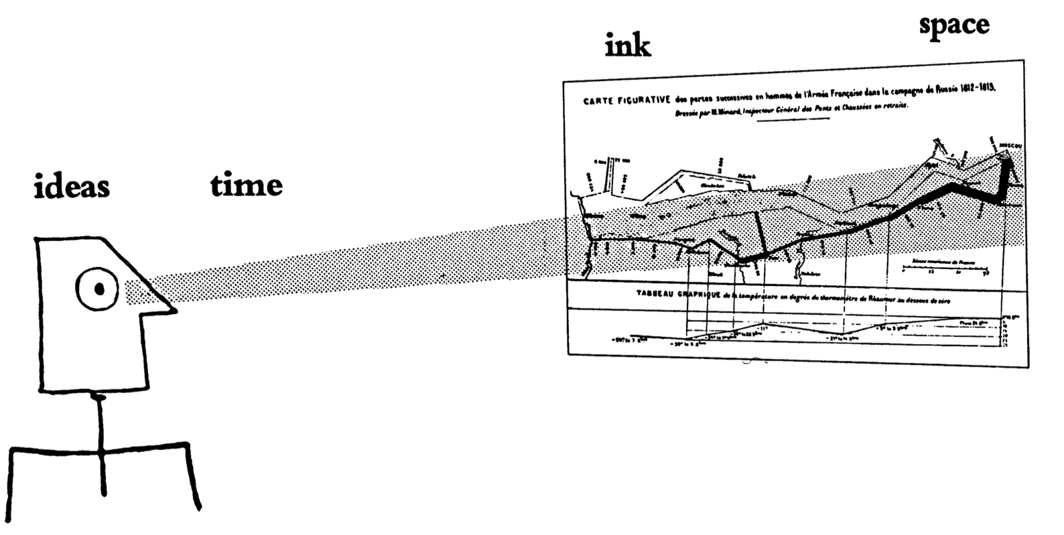
Graphical excellence gives the viewer:
the greatest # of ideas
in the shortest time
with the least ink
in the smallest space.

Slide 11
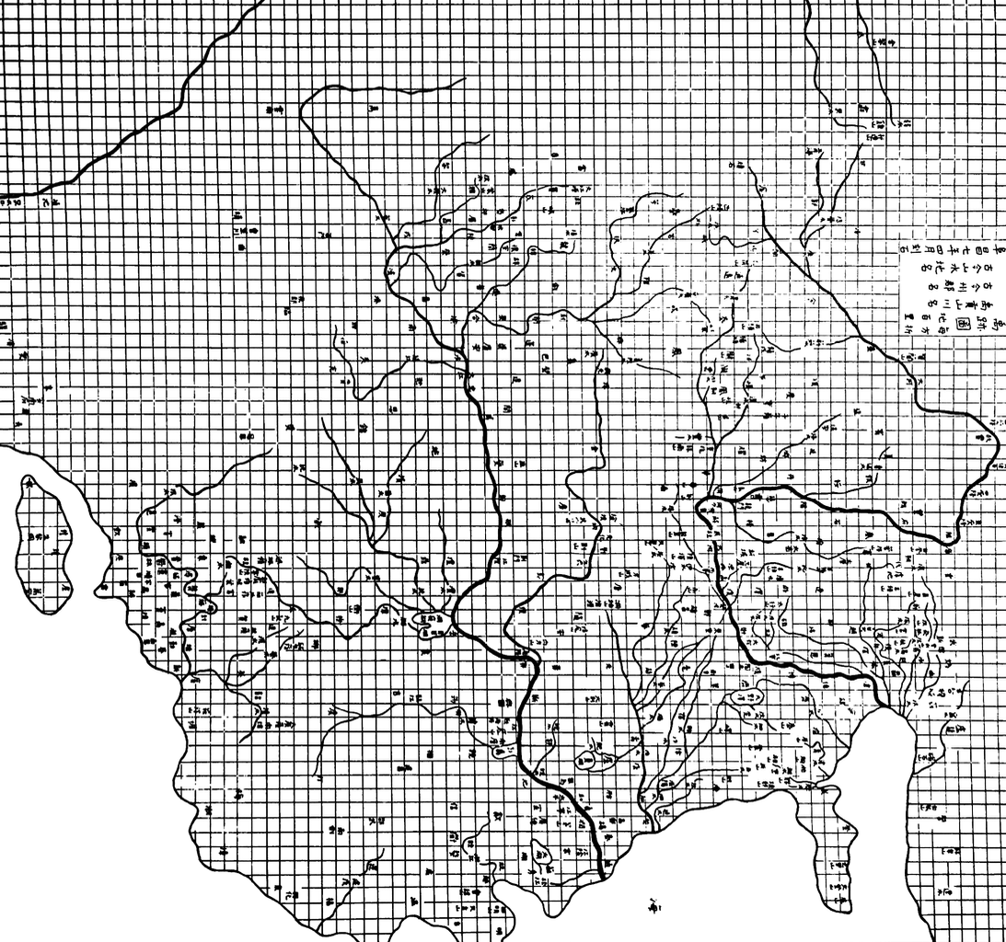
One of the oldest graphical displays
Yu Chi Thu
Map of the tracks of Yu the Great
Carved in stone in 1137 A.D.
(idea probably older)
Nothing similar in Europe until ~1550

Slide 12
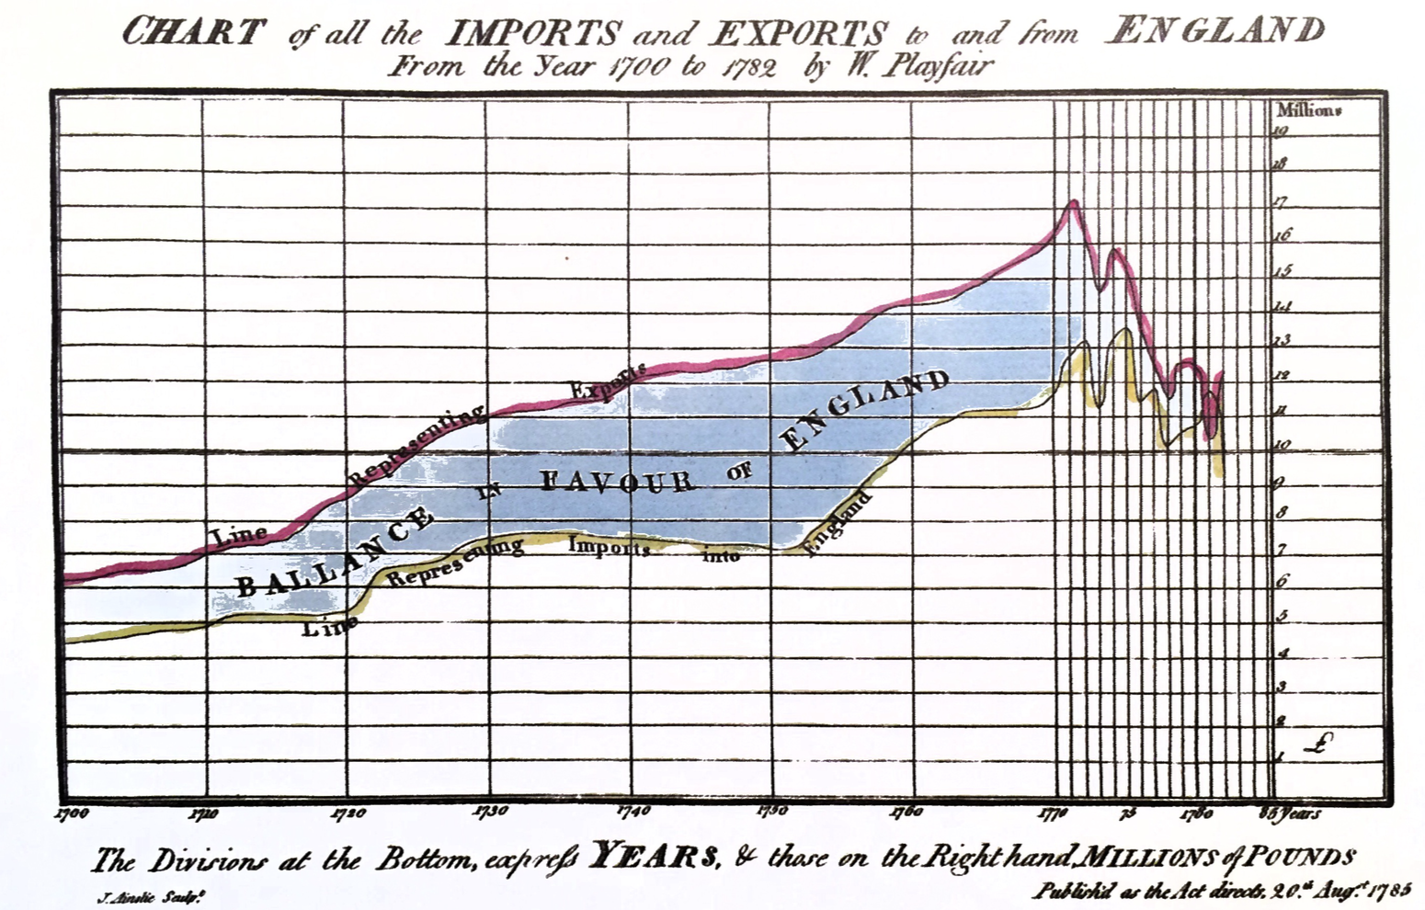
One of the earliest timeseries charts

Slide 13
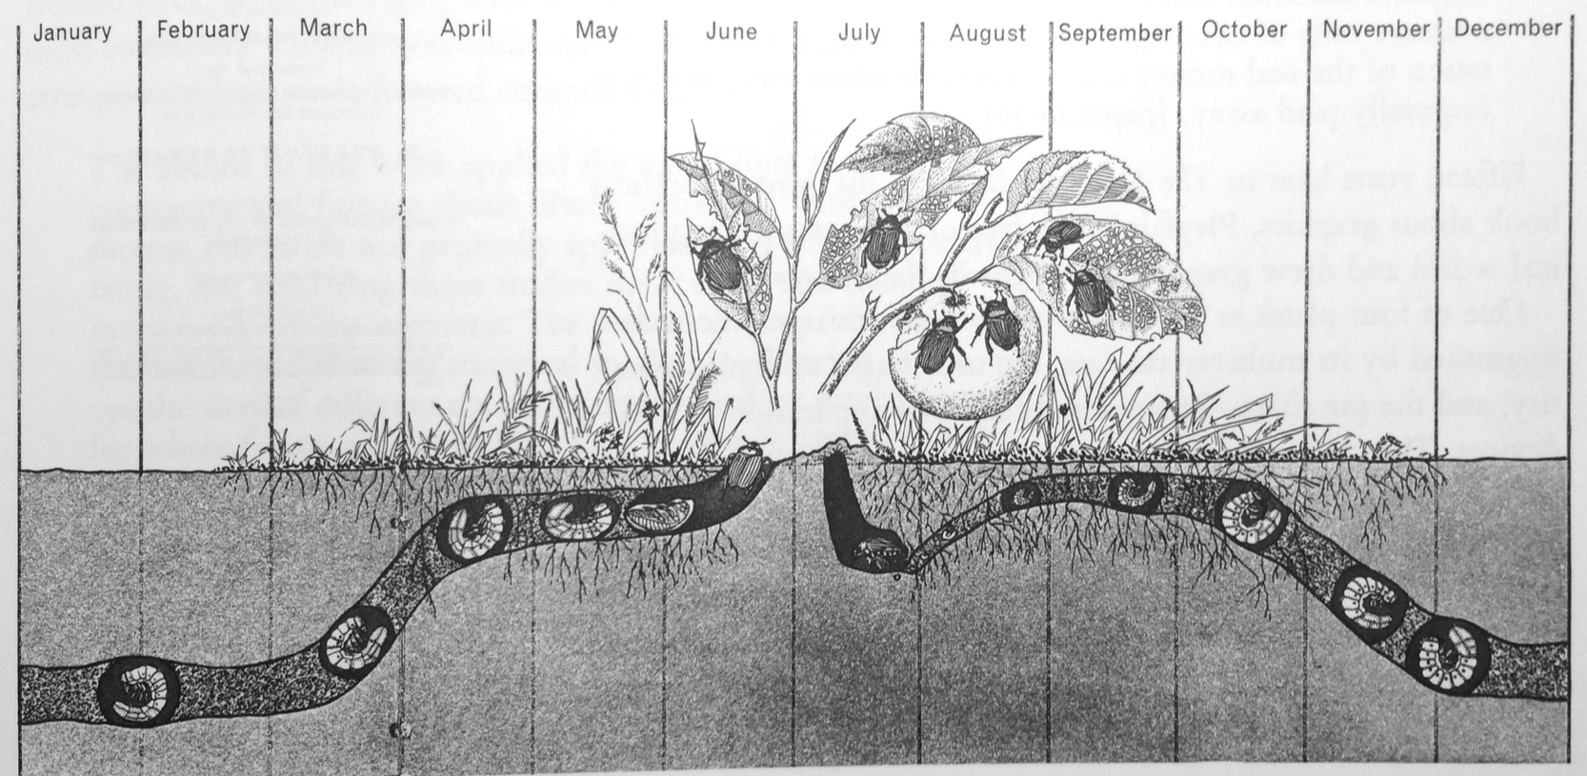
Life-cycle of the Japanese Beetle
L. Hugh Newman Man and Insects (London, 1965), pp 104-105

Slide 14
Strive For Graphical Integrity
Visual representations of data must tell the truth.

Slide 15
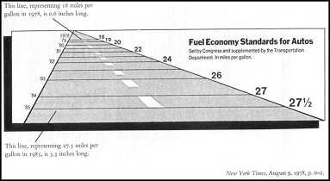
The Lie Factor
Size of effect in the visualization
Lie Factor =
Size of effect in the data
According to Tufte the Lie Factor of this graph is 14.8. A numerical change of 53% is represented by a graphical change (size of horizontal lines) of 783%.

Slide 16
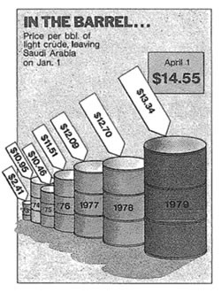
Graphical Integrity
The representation of numbers, as physically measured on the surface of the graph itself, should be directly proportional to the numerical quantities represented

Slide 17
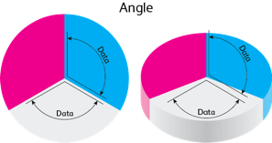
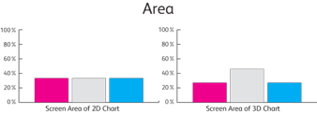
Graphical Integrity
The number of information carrying (variable) dimensions depicted should not exceed the number of dimensions in the data.

Slide 18
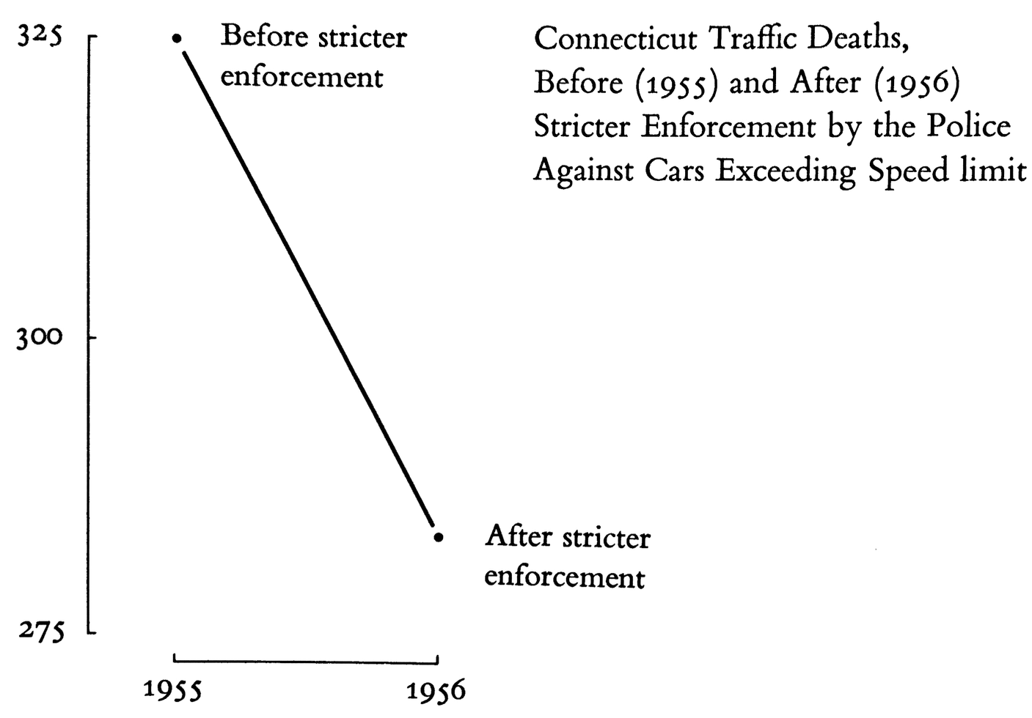
Graphical Integrity
Graphics must not quote data out of context.

Slide 19
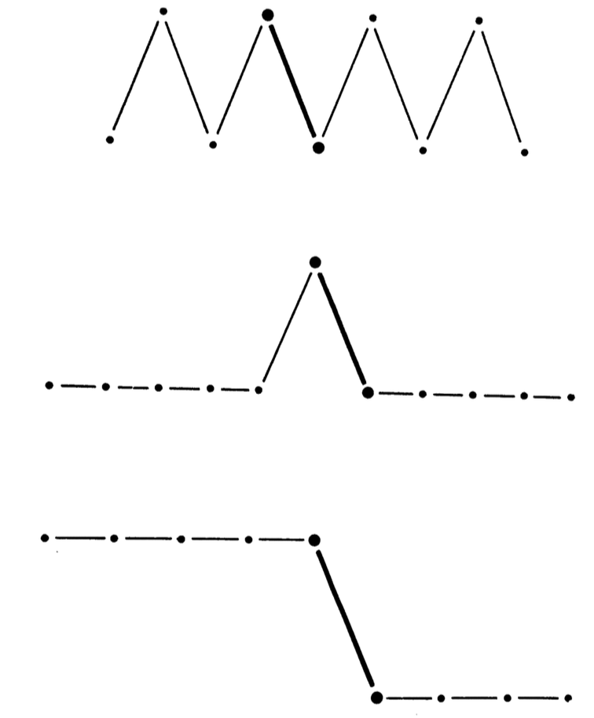
Graphical Integrity
Graphics must not quote data out of context.

Slide 20
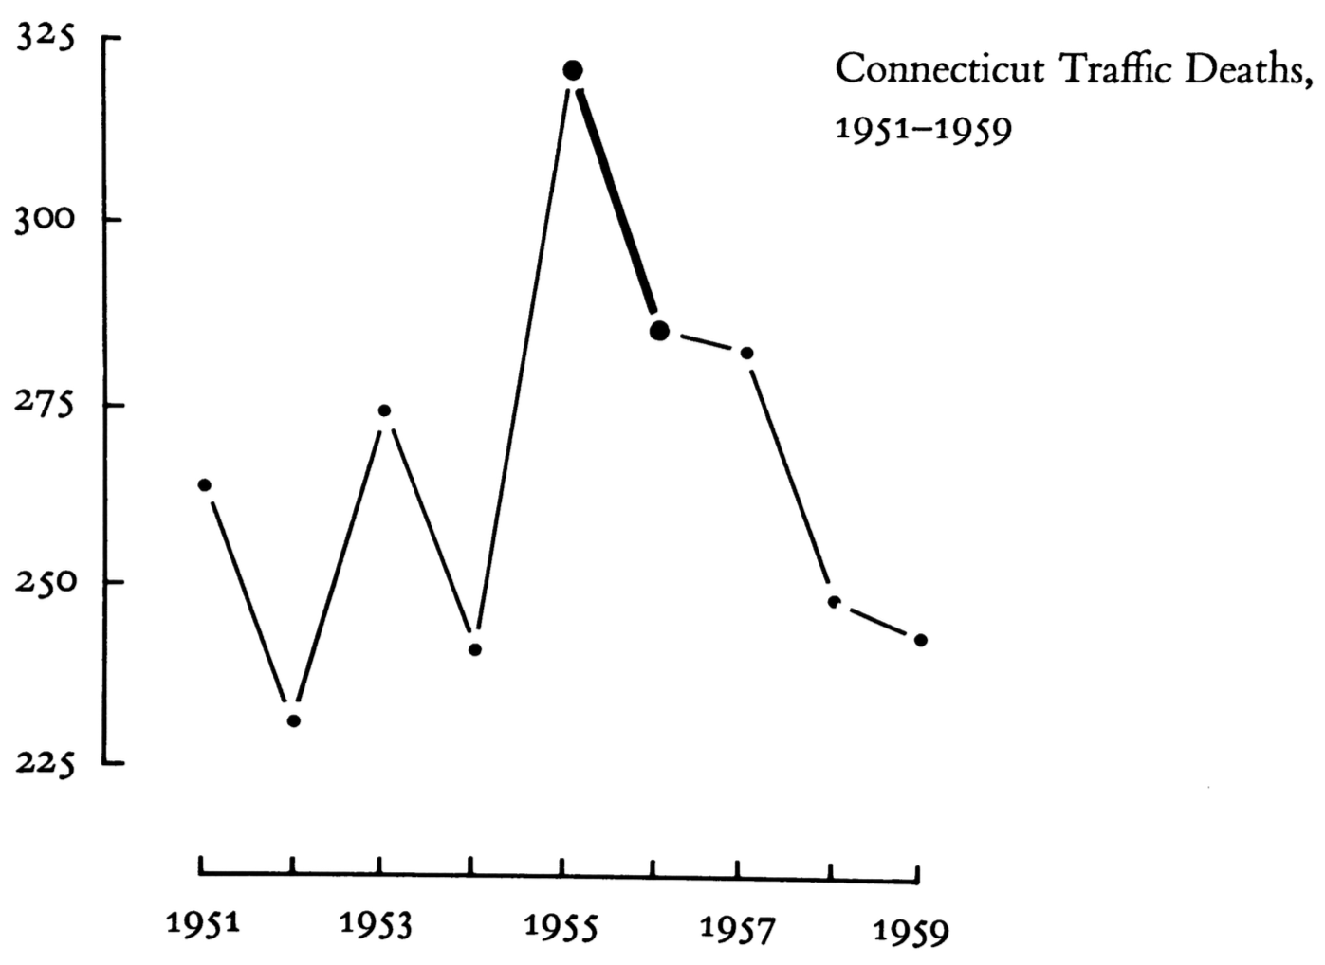
Graphical Integrity
Graphics must not quote data out of context.

Slide 21
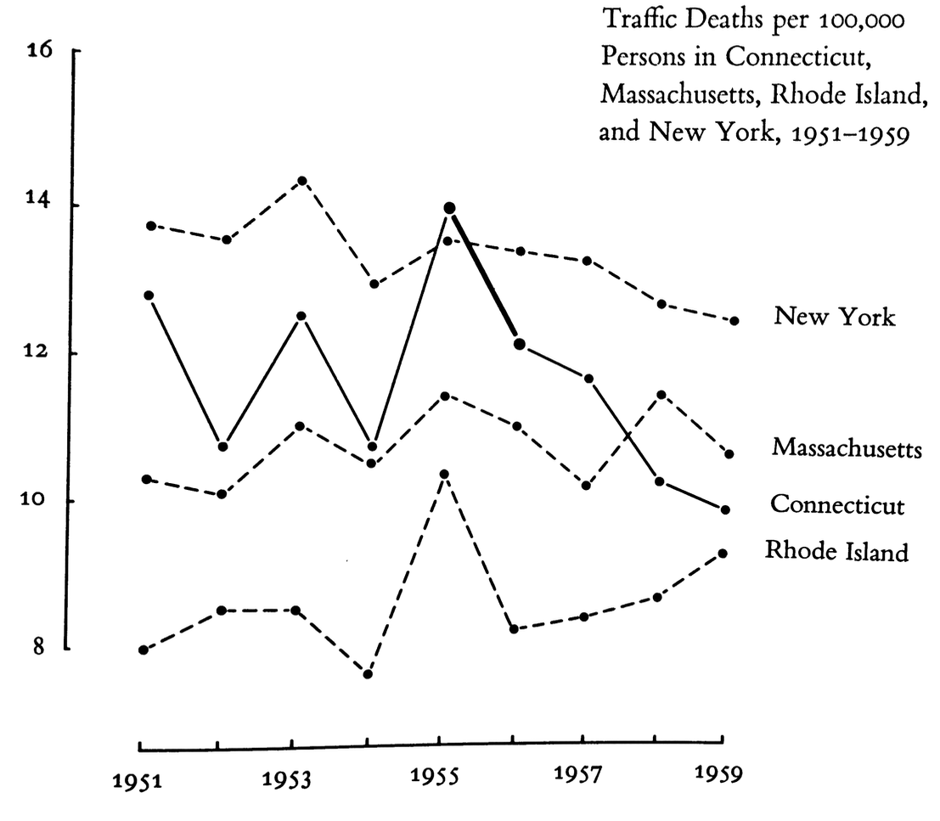
Graphical Integrity
Graphics must not quote data out of context.

Slide 22
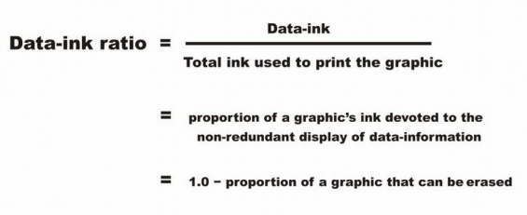
Maximize Data Ink

Slide 23
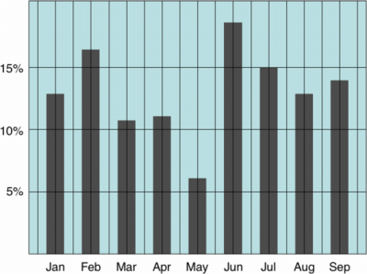
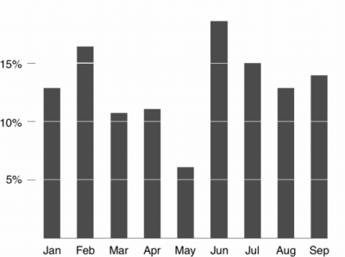
Example: High or Low Data Ink ratio?

Slide 24
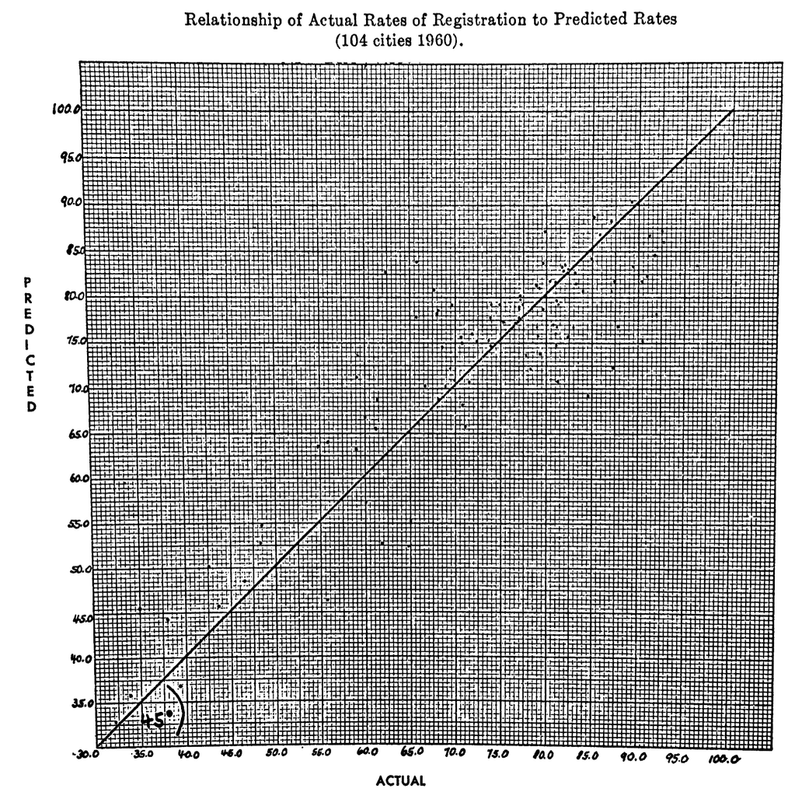

Slide 25
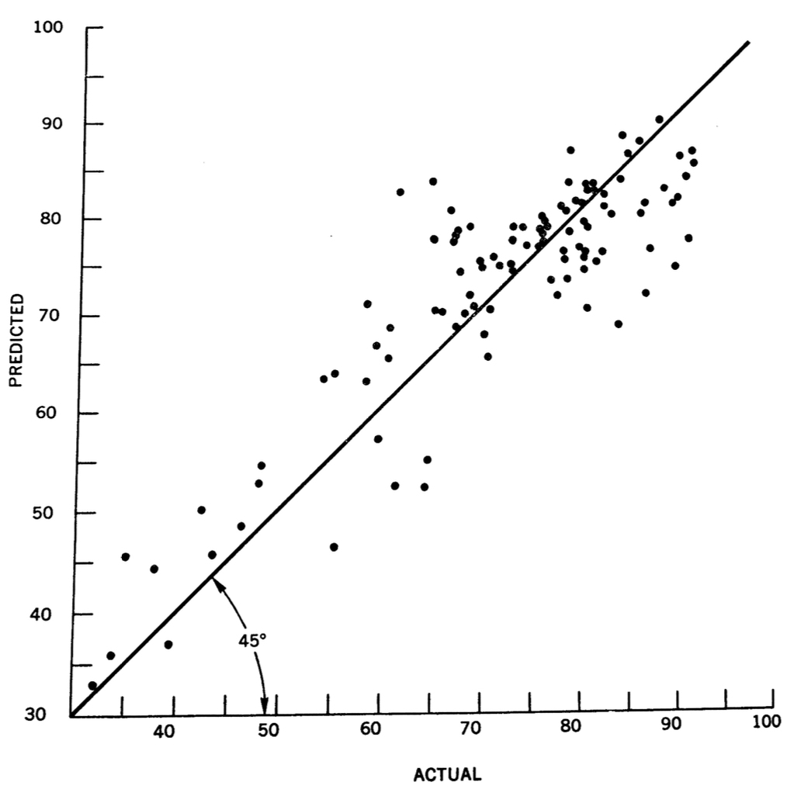

Slide 26
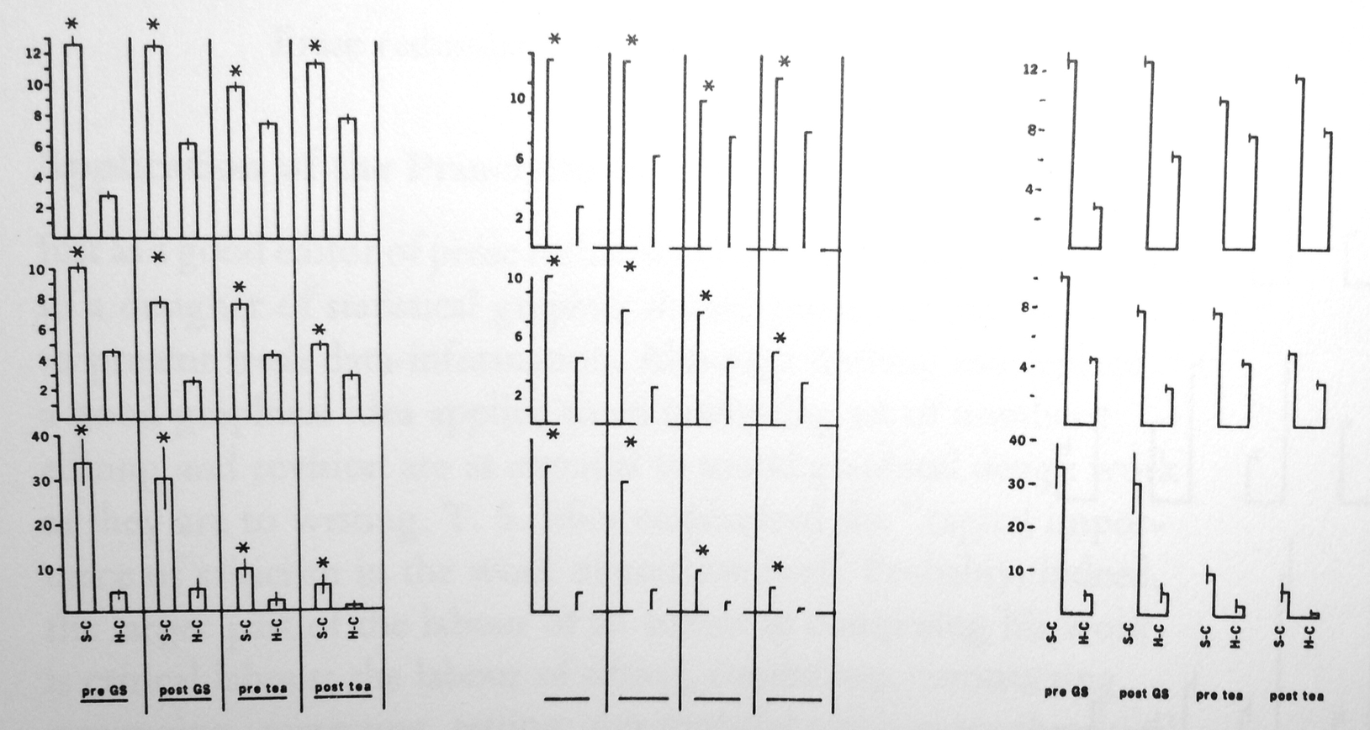
Maximize Data Ink
Trim the fluff from your graphics as much as possible!

Slide 27
Avoid Chart Junk
The excessive and unnecessary use of graphical effects in graphs used to demonstrate the graphic ability of the designer rather than display the data.

Slide 28
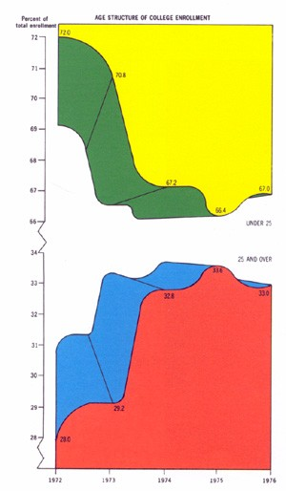
CHART JUNK
5 Colors
2 Curvy lines
2 Polygons
2 Broken Axis
3 Dimensions
To display:
5 numbers
Possibly the worst graph
ever made

Slide 29
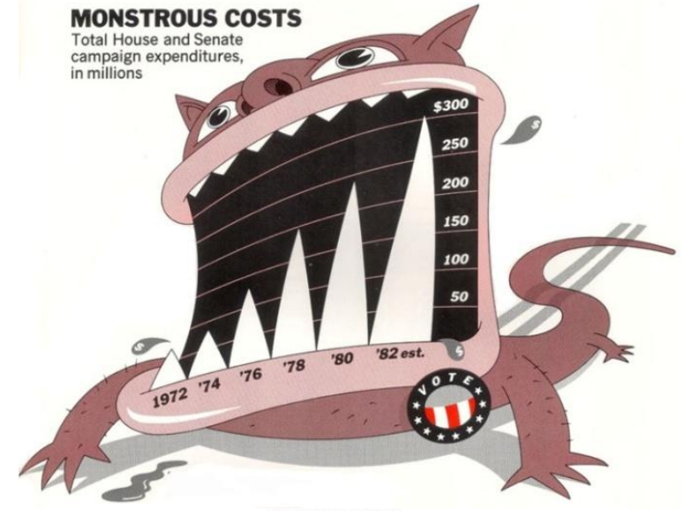

Slide 30
Aim for high data density
The proportion of the total size of the graph that is dedicated displaying data.

Slide 31
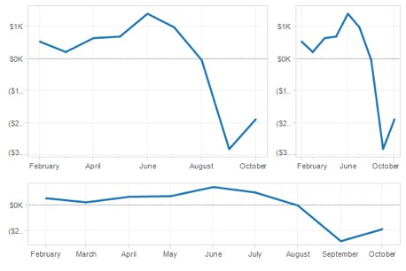
Shrink Principle
Many graphs can be shrunk way down without losing legibility or information

Slide 32
Small Multiples
Series of the same small graph repeated in one visual

Slide 33
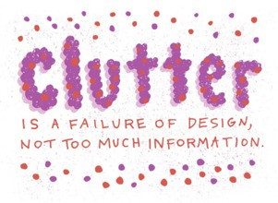
Clutter
Visualization too cluttered?
Don't remove data, change the design.
Credibility comes from detail and in many cases one can clarify a design by adding detail.

Slide 34
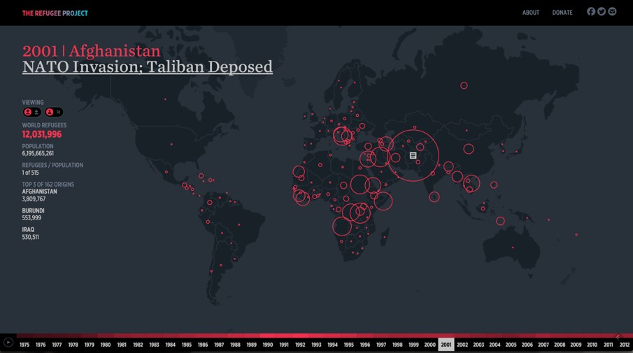
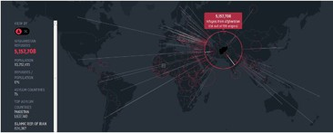
Hyperakt and Ekene Ijeoma visualized migrations over time and space in The Refugee Project http://www.therefugeeproject.org

Slide 35
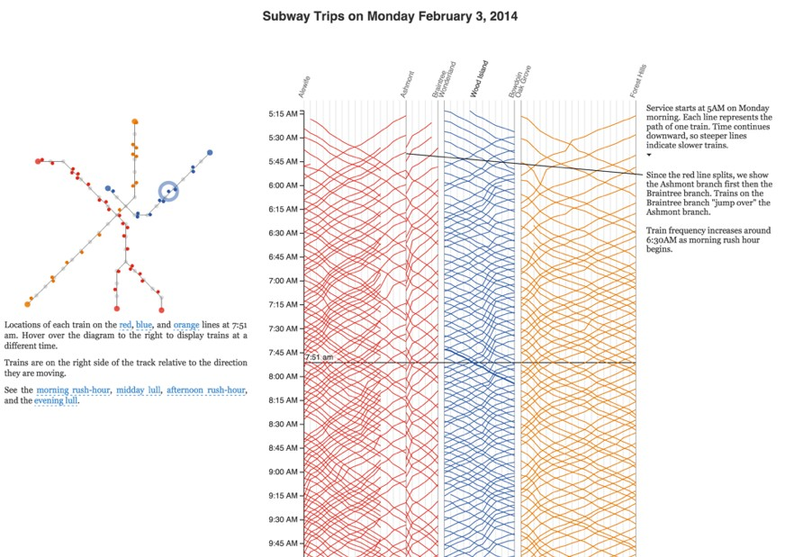
Notes:
For a graduate project, Michael Barry and Brian Card explored the Boston subway system through a set of annotated interactives that show train routes, usage, and scheduling. http://mbtaviz.github.io/

Slide 36
Layering & Separation
Use color or other differentiation to separate important classes of information.

Slide 37
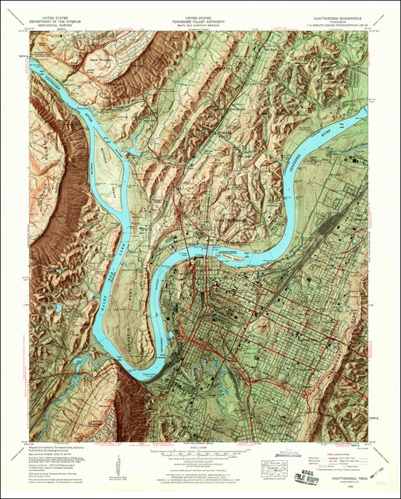
Muted colors, subtle shading and thin contour lines allow multiple types of data to be layered together in this 1958 topographic map of Chattanooga, Tennessee.

Slide 38
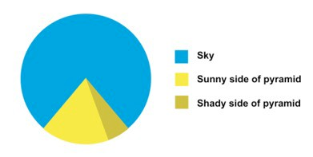
1 + 1 = 3 (or more)
Effective layering of information is difficult because of interactions
Can create non-information patterns and texture

Slide 39
Moire effect

Slide 40
Select the appropriate graphic for the data & analysis

Slide 41
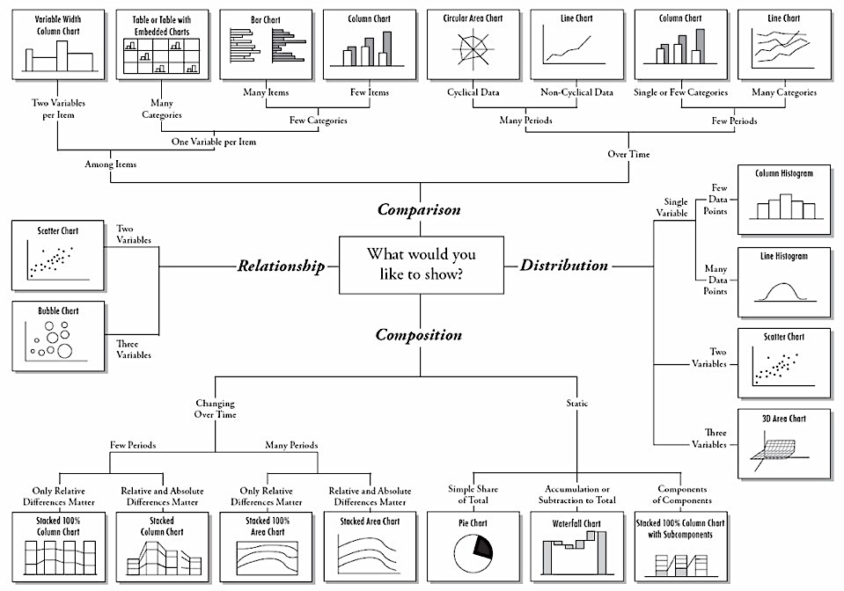
Chart by Andrew Abela

Slide 42
Aesthetics & Technique
Carefully chosen graphical format
Design uses words, numbers, and drawings
Displays an accessible complexity of detail
Has a narrative quality, a story to tell about the data
Technical details of production done with care
Avoid content-free decoration, including chartjunk

Slide 43
Juan Velasco. Cornell ornithologist Edwing Scholes and biologist/photographer Tim Laman. Senior Graphics Editor Fernando Baptista, Graphics Specialist Maggie Smith and freelance researcher Fanna Gebreyesus. National Geographic

Slide 44
The final word…
The principles should not be applied rigidly or in a peevish spirit; they are not logically or mathematically certain; and it is better to violate any principle than to place graceless or inelegant marks on paper
--Tufte, Visual Display of Quantitative Information, page 191

